Slide 1
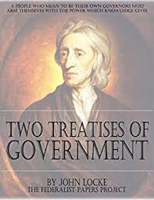
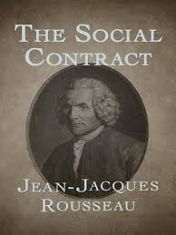
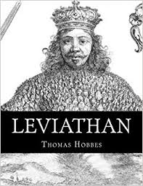
The State of Nature Game
Hobbes
Leviathan
1651
Locke
Two Treatises
1689
Rousseau
The Social Contract
1762
Notes:
3 Important “state of nature” theorists. SoN is a probably fictitious time in human society before government existed. Hobbes called it a war of all against all. Debate important for political science because it directly relates to the justification for the existence of formal government– the STATE.
We discussed the pessimistic view of human nature that Hobbes had. His description of the state of nature as a war of all against all forms the basis for what would, much later in the 20th century, become the most famous game in all of game theory: the prisoner’s dilemma. We’ll call lit the “state of nature game.” These slides accompany the scanned pdf in Module 3 called “State of Nature Game”. They are from the first Clark, golder, and Golder book, Principles of Comp Politics.

Slide 2
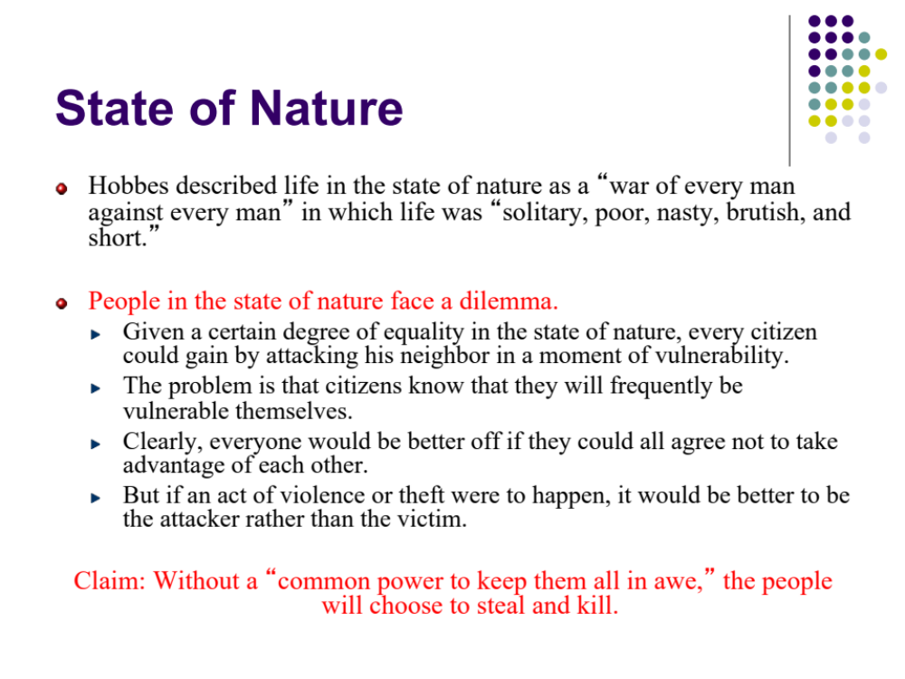
State of Nature
Hobbes described life in the state of nature as a “war of every man against every man” in which life was “solitary, poor, nasty, brutish, and short.”
People in the state of nature face a dilemma.
  Given a certain degree of equality in the state of nature, every citizen could gain by attacking his neighbor in a moment of vulnerability.
  The problem is that citizens know that they will frequently be vulnerable themselves.
  Clearly, everyone would be better off if they could all agree not to take advantage of each other.
  But if an act of violence or theft were to happen, it would be better to be the attacker rather than the victim.
Claim: Without a “common power to keep them all in awe,” the people will choose to steal and kill.

Slide 3
State of Nature
Game theory can help us understand the interaction between people in the state of nature.
Imagine that we have two individuals (A and B) in the state of nature who have to decide whether or not to steal from each other.

Slide 4
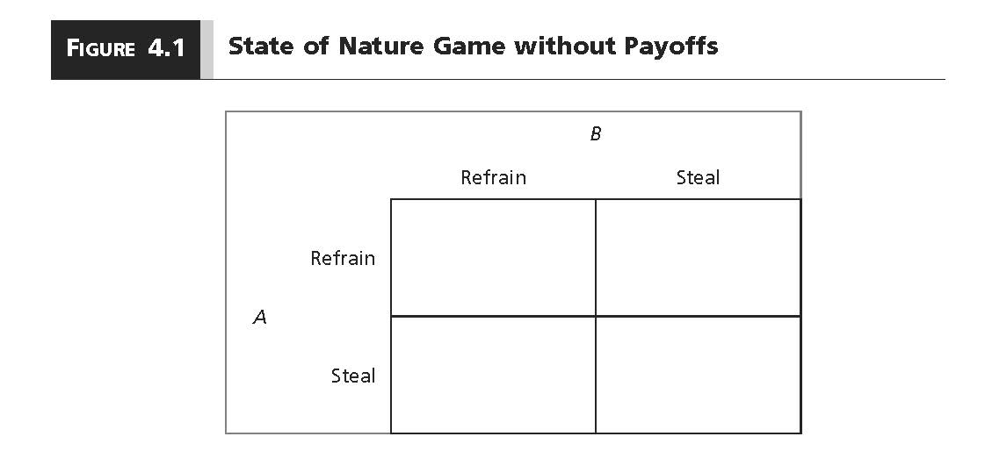
State of Nature Dilemma
What do we expect the individuals to do?
Notes:
There are 4 possibilities: Both refrain, both steal, A refrains and B steals, and A steals and B refrains.

Slide 5
Preference Orderings
A preference ordering indicates how a player ranks the possible outcomes of a game.
  (A’s strategy; B’s strategy)
Individual A:
(Steal; Refrain)>(Refrain; Refrain)>(Steal; Steal)>(Refrain; Steal)
Individual B:
(Refrain; Steal)>(Refrain; Refrain)>(Steal; Steal)>(Steal; Refrain)
From the preference orderings, we can create payoffs
  Give 4 to the most preferred, 3 to next preferred, and so on.
Notes:
Greater than sign can just be understood a meanings “is preferred to”

Slide 6
Payoffs
Outcome | Description | Player A | Player B
O1 | Player A steals, Player B refrains. | 4 | 1
O2 | Player A steals, Player B steals. | 2 | 2
O3 | Player A refrains, Player B refrains. | 3 | 3
O4 | Player A refrains, Player B steals. | 1 | 4
Ordinal payoffs allow us to know how players rank order the outcomes; they do not tell us how much more the players prefer one outcome to another.

Slide 7
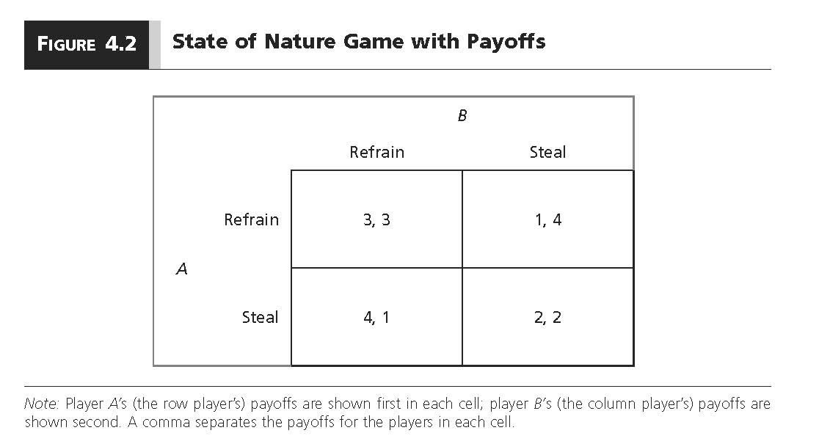
State of Nature Dilemma
Notes:
We did the same thing with rock paper scissors, and which side of the road to drive on.

Slide 8
Solving the Game
We solve the game for Nash equilibria.
A “Nash equilibrium” is a set of strategies (one for each player) such that no player has an incentive to unilaterally switch to another strategy.
  Both players must be playing “best replies.”
  A best reply is the action that yields the highest payoff given what the other player is doing.
A strategy is a complete plan of action that specifies what a player would do under every possible circumstance that might arise in the game
Notes:
Again, we talked about this wrt RPS and driving. A best reply is sometimes also known as a best response.

Slide 9
Solving the Game
Step 1: Put yourself in the shoes of individual A.
  What would you do–what is your best reply–if individual B chooses to refrain?
  What would you do–what is your best reply–if individual B chooses to steal?

Slide 10
State of Nature Dilemma
Notes:
We did the same thing with rock paper scissors, and which side of the road to drive on.

Slide 11
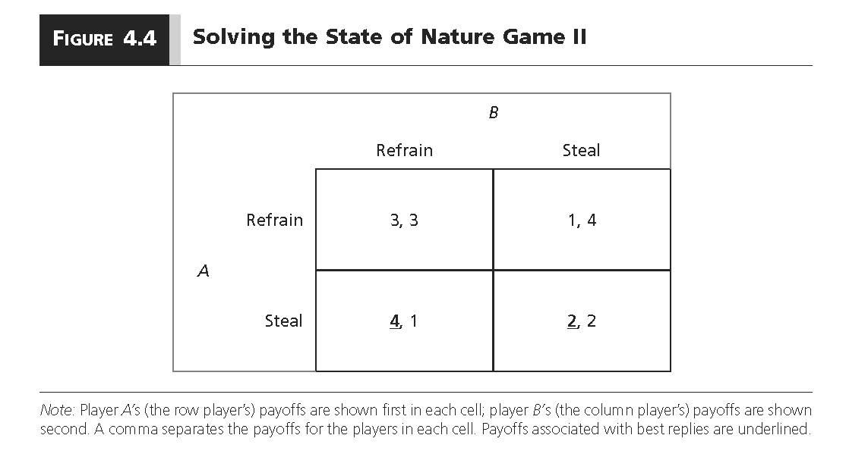
State of Nature Dilemma
Forbear
Steal
3,3 | 1,4
4,1 | 2,2
Forbear
Player A
Steal

Slide 12
Solving the Game
Step 2: Put yourself in the shoes of individual B.
  What would you do–what is your best reply–if individual A chooses to refrain?
  What would you do–what is your best reply–if individual A chooses to steal?

Slide 13
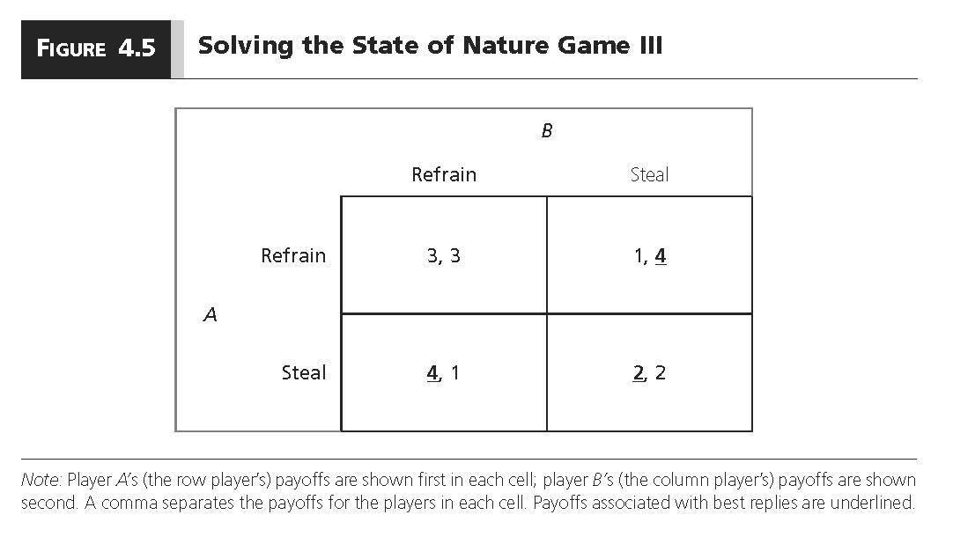
State of Nature Dilemma
Player B
Forbear
Steal
3,3 | 1,4
4,1 | 2,2
Player A
Steal

Slide 14
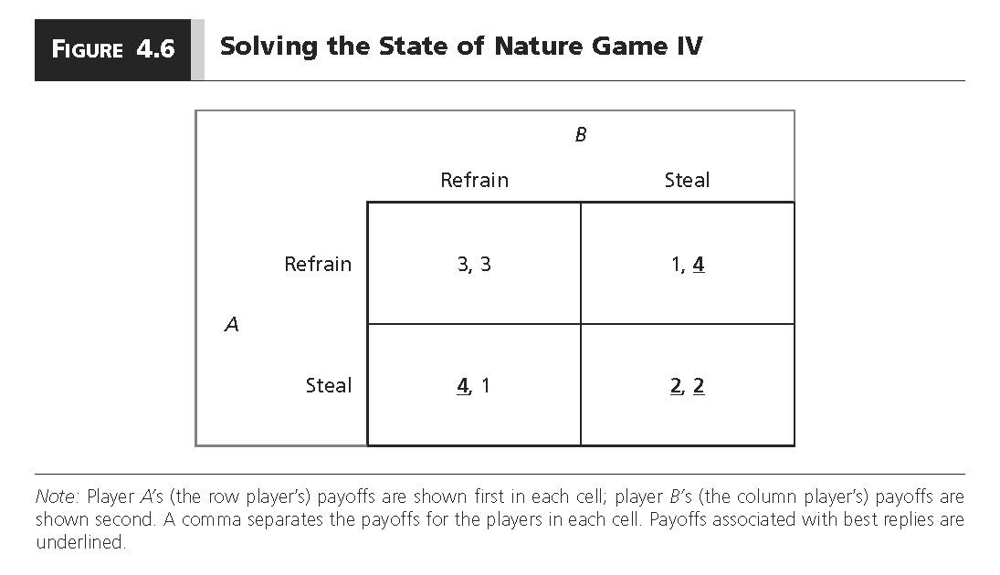
State of Nature Dilemma
Player B
Forbear
Steal
3,3 | 1,4
4,1 | 2,2
Forbear
Player A
Steal
Notes:
This “underline method” can be used to solve ANY game that uses a payoff matrix like this one.

Slide 15
Solving the Game
Any square in which both numbers are underlined is a Nash equilibrium
  Both players are playing best replies in these situations.
NE: (Steal; Steal).
Payoffs: (2,2).
Outcome: Both individuals steal.

Slide 16
Solving the Game
A player is said to have a dominant strategy if that strategy is a best reply to all the other players’ strategies.
A “dominant strategy Nash equilibrium” occurs when both players have a dominant strategy.
There is a dominant strategy NE in our State of Nature Game.

Slide 17
State of Nature Dilemma
Player B
Forbear
Steal
3,3 | 1,4
4,1 | 2,2
Forbear
Player A
Steal
Both players have a dominant strategy to steal.
Therefore, the NE is a dominant strategy NE.

Slide 18
State of Nature Game
As Hobbes pointed out, individuals will live in a persistent state of fear when there is nobody to keep them in a state of “awe.”
The SoN Game’s dominant strategy equilibrium of (steal, steal) is consistent with Hobbes pessimistic outlook on the SoN.
“State of nature” may seem abstract, but consider situations in which no single actor can “awe” everyone in society.
In fact, Nobel laureate Robert Fogle argues that Hobbes’s state of nature describes most of human history

Slide 19
State of Nature Dilemma
Player B
Forbear
Steal
3,3 | 1,4
4,1 | 2,2
Forbear
Player A
Steal
What’s weird about this equilibrium?

Slide 20
State of Nature Game
What’s weird is that the NE is the second worst outcome for both players.
  Both individuals would be better off if they just chose to refrain! They’d get 3 instead of 2.
Why can’t both individuals just agree not to steal?
What would you do if the other individual promised not to steal from you?

Slide 21

State of Nature Dilemma
Player B
Refrain
Steal
3,3 | 1,4
4,1 | 2,2
Refrain
Player A
Steal
The promise to refrain is not credible because both players have an incentive to steal no matter what the other player does.
Notes:
Notice how this is different than the circular cycle of arrows in Rock Paper Scissors—it was circular because there was no equilibrium. Here, all roads lead to Steal. The SoN game is really a bummer.
One bright note is that when real people play the SoN game, many of them do not steal!

Slide 22
State of Nature Game
Individuals have a dominant strategy to cheat, steal, kill, and the like.
Both players get their second worst outcome, even though they could get their second best outcome if they could just agree to refrain.
The absence of cooperation represents a sort of dilemma--individual rationality leads actors to an outcome that is inferior in the sense that BOTH players agree that the same alternative outcome is better.

Slide 23
State of Nature
So, how can we solve the state of nature dilemma?
How can we get out of the state of nature?

Slide 24
The Social Contract and the State
Hobbes’s solution to the state of nature was to create a sovereign with sufficient control of force that individuals would stand in “awe.”
He believed that the state of nature was so bad that individuals would be willing to transfer power and so on to the sovereign in exchange for protection.
This would be achieved with the help of a social contract.

Slide 25
The Social Contract and the State
A social contract is an implicit agreement among individuals in the state of nature to create and empower the state. In doing so, it outlines the rights and responsibilities of the state and citizens in regard to each other.
  Citizens would give up their natural rights in exchange for civil rights that would be protected by the sovereign
The social contract should produce a sovereign that is strong enough to dole out punishments to individuals who “steal.”
  These punishments should be sufficiently large that individuals would no longer have a dominant strategy to “steal.”

Slide 26
New Payoffs with State
Outcome | Description | Player A | Player B
O1 | Player A steals, Player B refrains. | 4-p | 1
O2 | Player A steals, Player B steals. | 2-p | 2-p
O3 | Player A refrains, Player B refrains. | 3 | 3
O4 | Player A refrains, Player B steals. | 1 | 4-p
We are going to switch to cardinal payoffs now. Cardinal payoffs allow us to know how much more the players prefer one outcome to another.

Slide 27
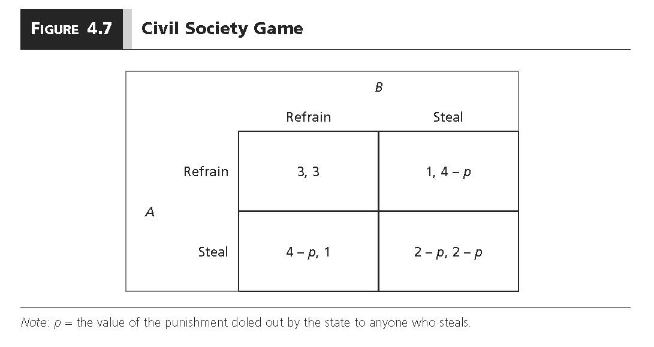
Living in Civil Society
Forbear
Steal
3,3 | 1,4-p
4-p,1 | 2-p,2-p
Forbear
Player A
Steal
Same game as before but now with a state lurking in the background punishing individuals who steal.

Slide 28
Civil Society Game
Is the creation of a state that can dole out punishments sufficient to induce good behavior on the part of the individuals?
It depends.

Slide 29
Living in Civil Society
Player B
Forbear
Steal
3,3 | 1,4-p
4-p,1 | 2-p,2-p
Forbear
Player A
Steal
So long as the state chooses a punishment (p) sufficiently large, then the players will choose not to steal.
How big does p need to be in this game?

Slide 30
Living in Civil Society
Player B
Forbear
Steal
3,3 | 1,4-p
4-p,1 | 2-p,2-p
Forbear
Player A
Steal
p needs to be bigger than 1.
Why?

Slide 31
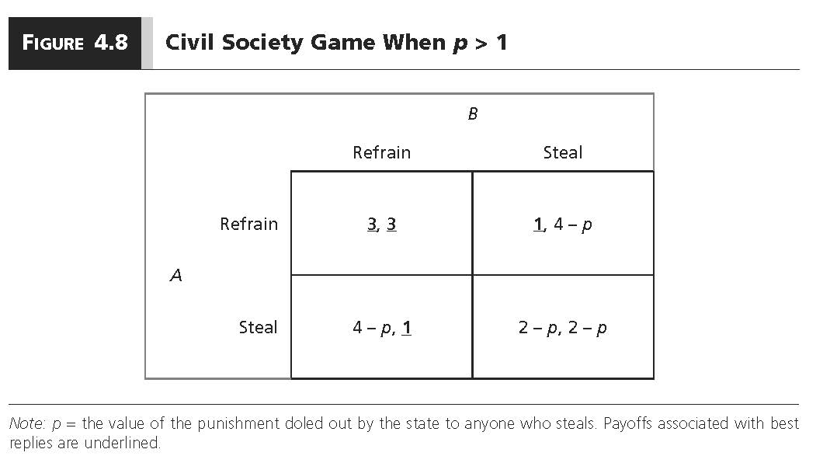
Living in Civil Society
Player B
Forbear
Steal
3,3 | 1,4-p
4-p,1 | 2-p, 2-p
Forbear
Player A
Steal
Individuals prefer not to steal when 3 > 4-p and 1 > 2-p.
This happens when p > 1.

Slide 32
Some Thoughts
Political theorists who see the state of nature as particularly dire expect citizens to accept a draconian set of responsibilities in exchange for the “protection” provided by the state.
  Hobbes was writing at the end of a long period of religious war in Europe and civil war in his home country. Thus, he had a firsthand glimpse of what the “war of all against all” looked like and thought that the difference between civil society and the state of nature was effectively infinite.
  It is perhaps for this reason that he believed that almost any level of taxation the state could levy on its citizens in exchange for protection looked like a good deal.

Slide 33
Some Thoughts
In contrast, political theorists who see civil society as a mere convenience rather than a workable, if inefficient, way of protecting individual rights, place much greater restrictions on what the state should ask of its citizens.
  Thomas Jefferson–borrowing from social contract theorist John Locke–believed that “life, liberty, and the pursuit of happiness” was possible in the state of nature and that our commitment to the state was so conditional that we should probably engage in revolution every couple of decades.

Slide 34
Some Thoughts
Contemporary disputes over whether we should reduce civil liberties by giving more power to the state in an attempt to better protect ourselves against terrorist threats or even a pandemic viruses directly echo this historical debate between scholars such as Hobbes and Locke.

